Slide 1


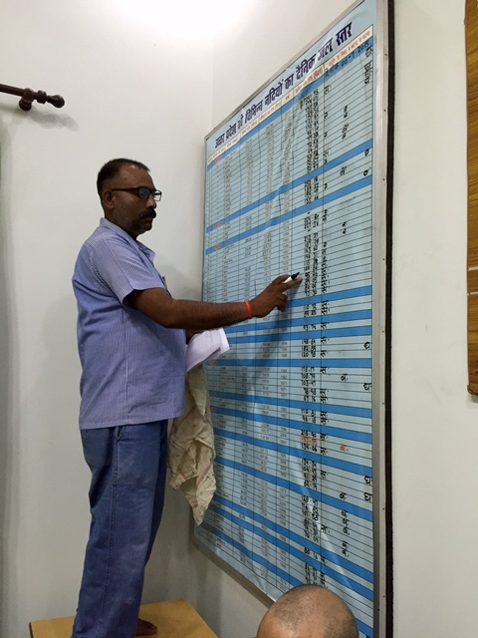
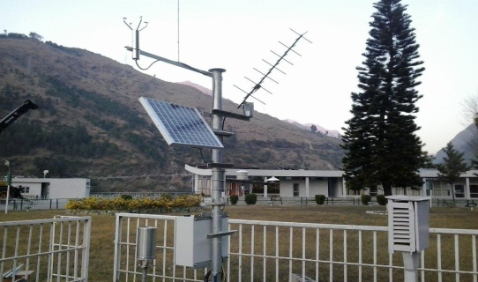
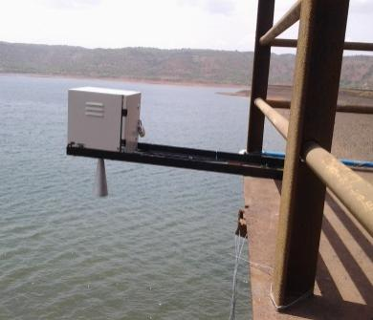
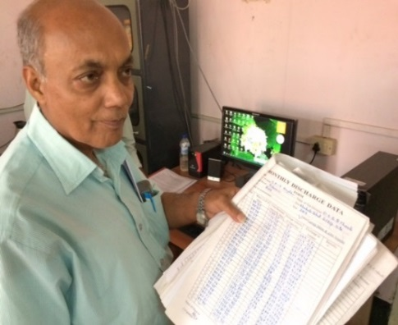
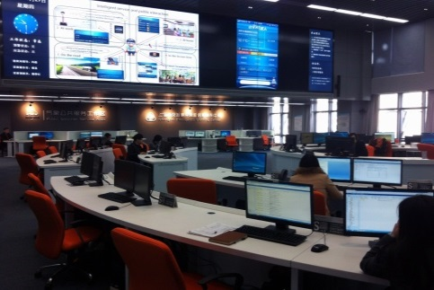
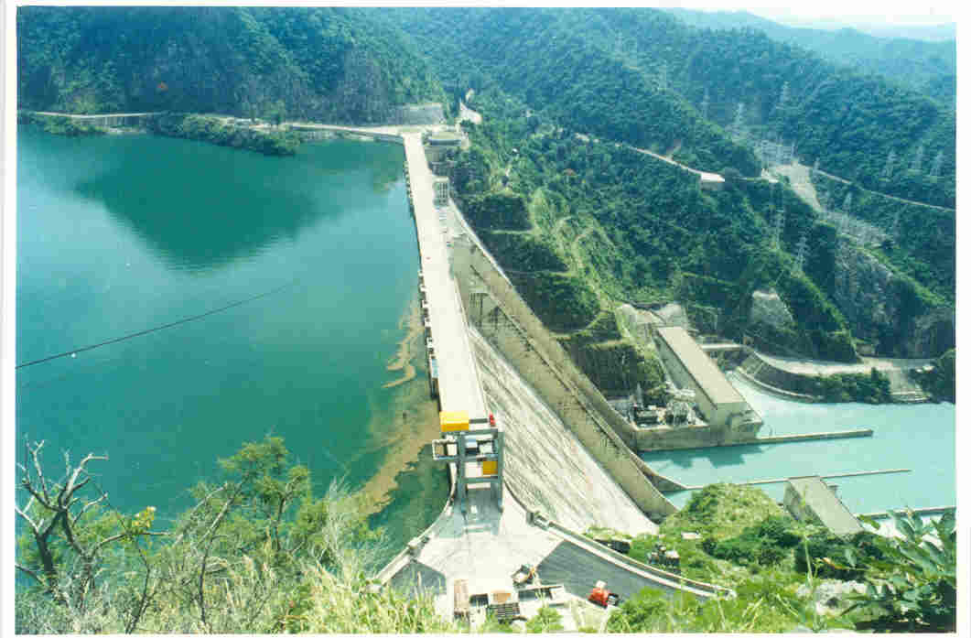
National Hydrology Project:
Integrated Water Resources Management
October 2015
RELIABLE, TIMELY, QUALITY, CONSISTENT, PUBLIC DATA
(www.indiawrm.org)

Slide 2
Concepts of National Hydrology Project
Standardizing Water Resources data and Information System for the country with uniform procedures and database.
Integration of River basin information with improved access to Centre, States and Public-domain.
Introducing country wide generic solutions for flood forecasting and River basin based water management.
Developing site specific solutions for water resources planning, operation and management including use of remote sensing based techniques.
2

Slide 3
NHP: Project Details
Project Objective:
To improve water resources planning and management across India by enhancing the scope, coverage and reliability of water resources information and strengthening the Water Resources institutions.
Project Components:
Water Data Acquisition System (WDAS)
Water Resources Information System (WRIS)
Water Resources Operation and Planning (WROP)
Institutions Capacity Enhancement
Budget Outlay: INR 3680 Crores
Duration: 8 years

Slide 4

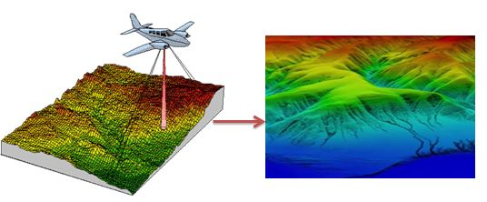
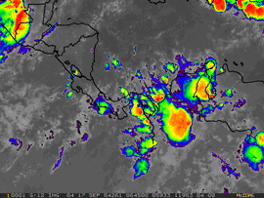
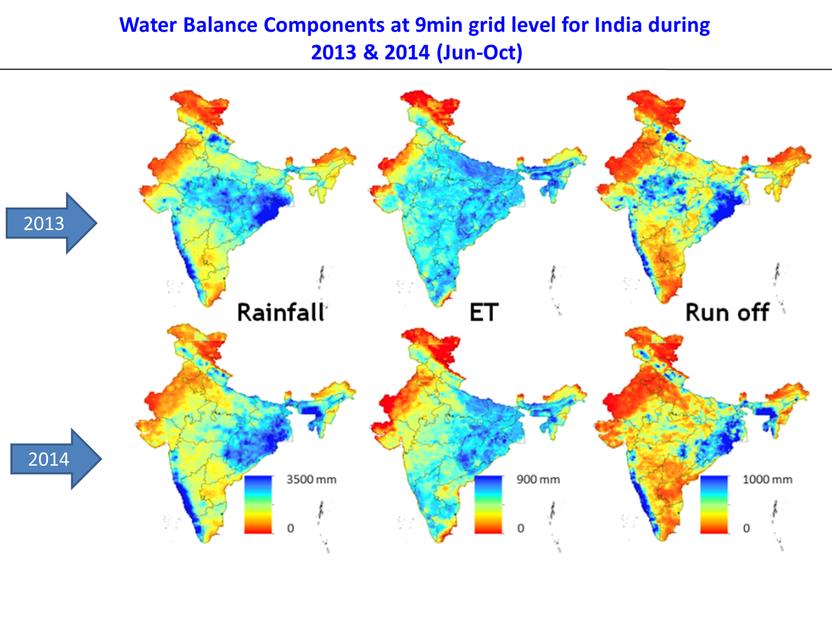
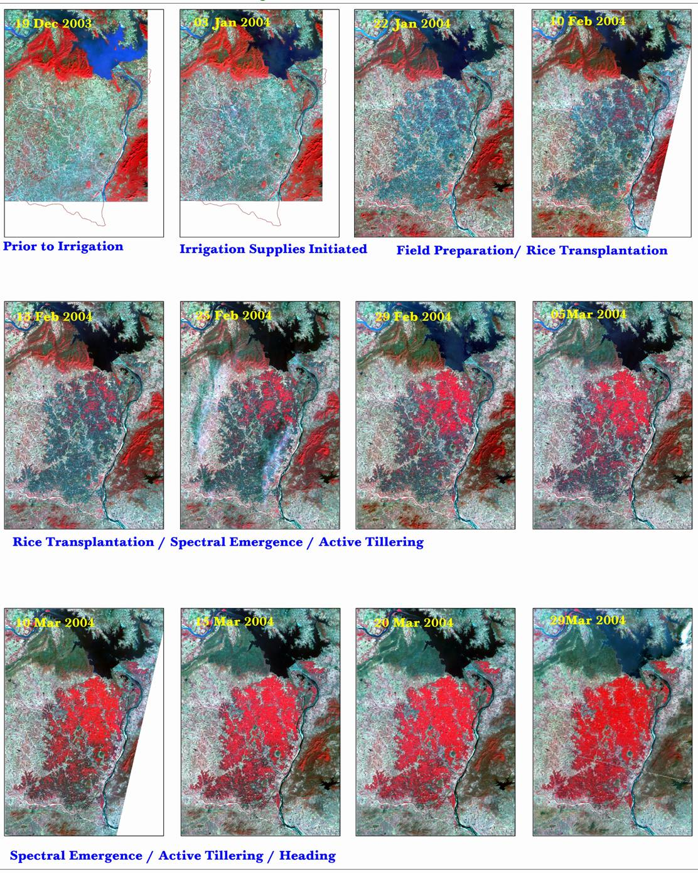
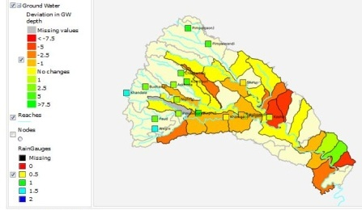
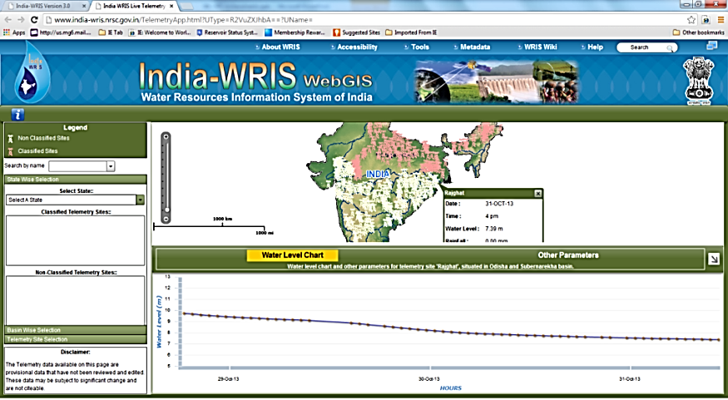
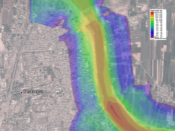
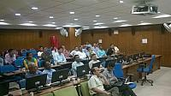
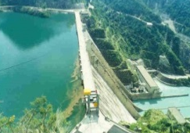
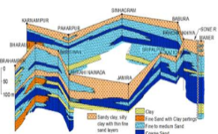
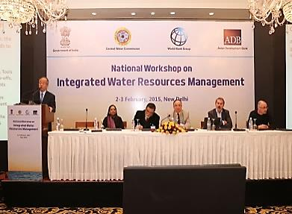
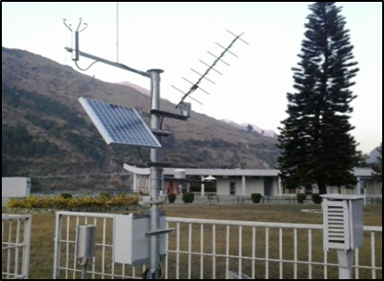
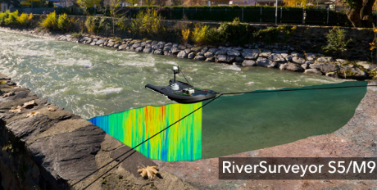

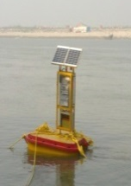
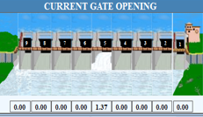
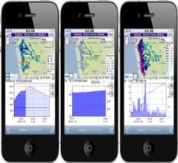
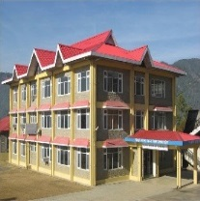
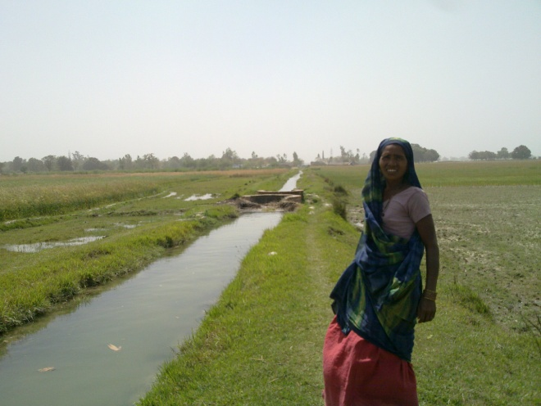
Better Basin Planning and Operational Decisions in Water Management
D. Institutional Strengthening and Capacity Building
C: Water Resources Planning
and Operation
B: Water Resources Information System
Centre of Excellence
GIS
Layers
High Resolution DEM
Weather Forecast
Generic Hydrological Products
Remote Sense Imageries
Collaboration with National/ International Institutes
DSS for Basin Planning
States-WRIS
Maharashtra
Karnataka
AP
Telangana
Krishna Basin WRIS
Flood management
Reservoir Operation
A: Water Data Acquisition System
Capacity Building
Groundwater management
Meteorological Monitoring
River/Reservoir Monitoring
Groundwater Monitoring
Water Quality Monitoring
SCADA for canal/ reservoir
Community monitoring/ crowd sourcing
State Data Centers
Outreach and Awareness
Irrigation management

Slide 5
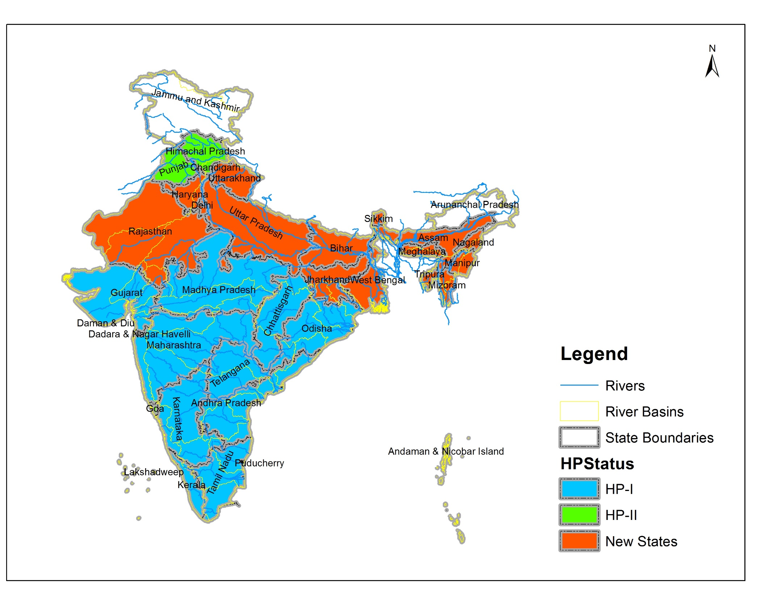
River Basin State map
Implementing Agencies | HP2 | New | Total
States | 19 | 17 | 36
UT | 1 |  | 1
Central agencies | 6 | 2 | 8
RBO | 1 | 1 | 2
Total | 27 | 21 | 47

Slide 6
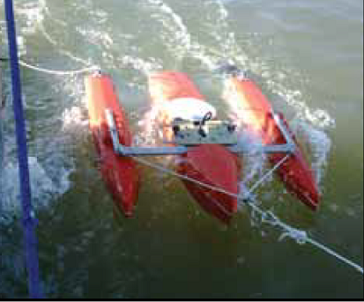

A: Water Resources Data Acquisition System
A1. Hydromet Observation
A2. Automated System Operation and Data Acquisition
A3. Hydro-Informatics Centers

Slide 7
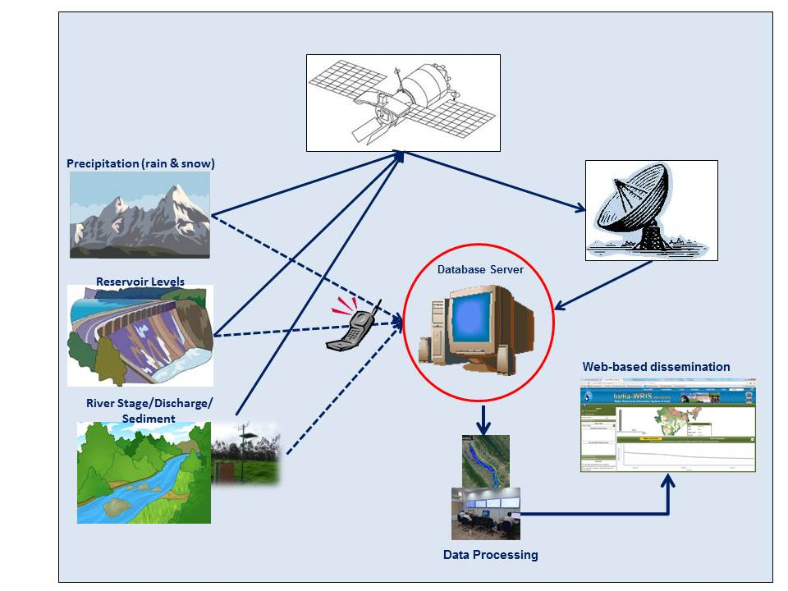
A1. Hydromet Observation

Slide 8
A1. Hydromet Observation
Proposed Hydro-met
Type of Station |  | Number
Automatic Rain gauges |  | 2452
Automatic Weather Stations |  | 559
Surface Water Level Monitoring | Rivers | 943
 | Dams / Barrages | 550
 | Canals | 423
 | Total | 1916
Ground Water Level Monitoring |  | 5744
Water Quality Sampling Sites |  | 1781

Slide 9
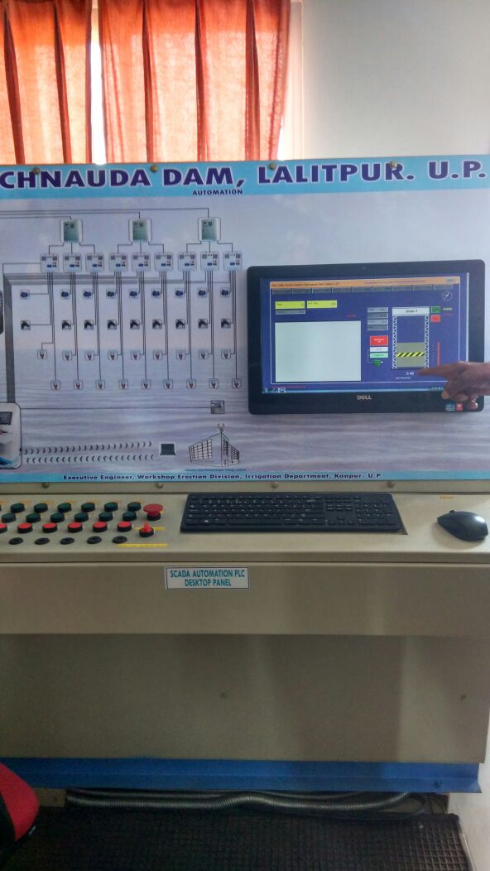
A2. Automated System Operation and Data Acquisition
Reservoir monitoring and automated Operation of gate
system for Reservoir/Barrages
UP
West Bengal
MP
Haryana
DVC
Canal Gate control system for major canal
MP, Rajasthan

Slide 10
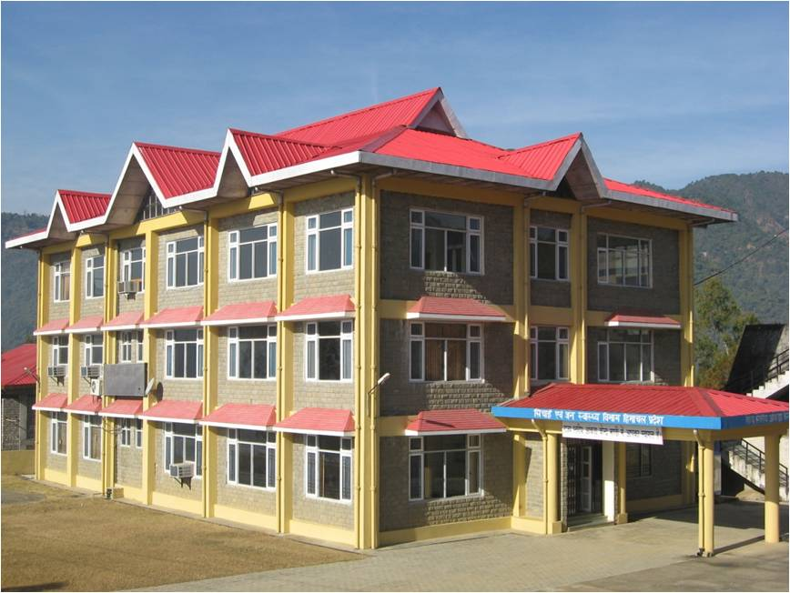
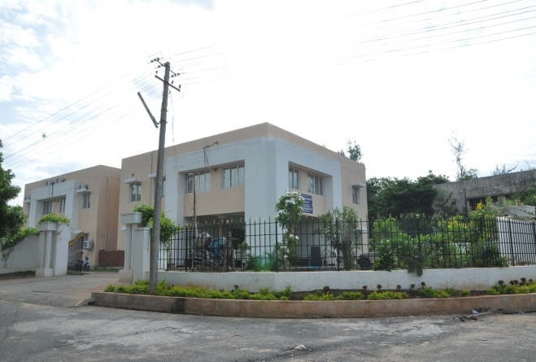
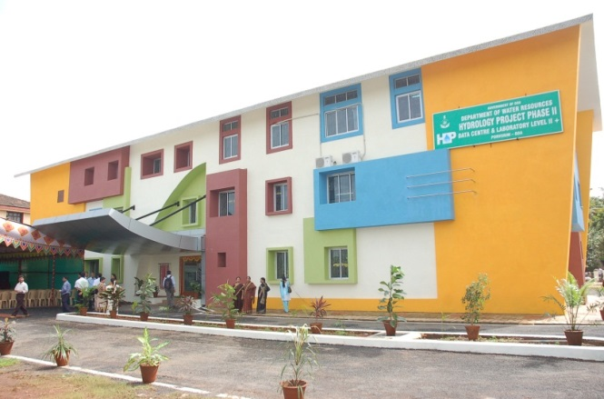
A3. Hydro-Informatics Centers
  All New NHP states have proposed for Data Centres
  All State Data Centers must be equipped with video conferencing systems

Slide 11
B: Water Resources Information System
B1.National Water Resources Information System
B2.State Water Resources Information System

Slide 12
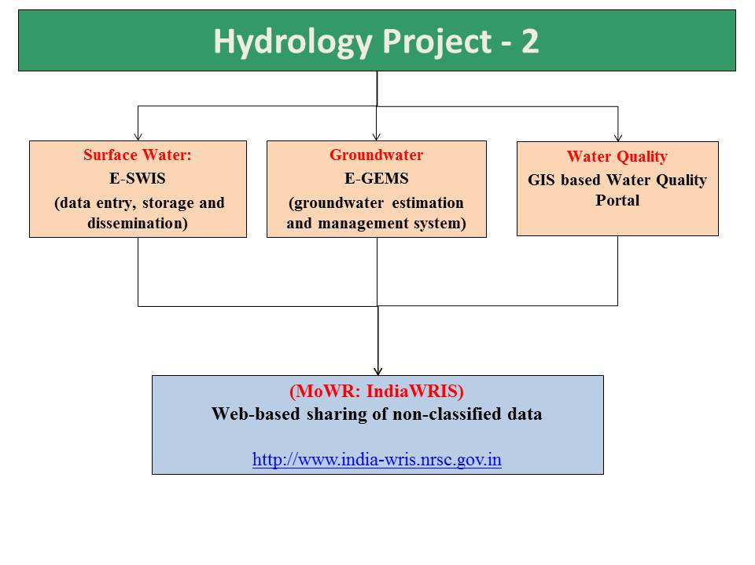
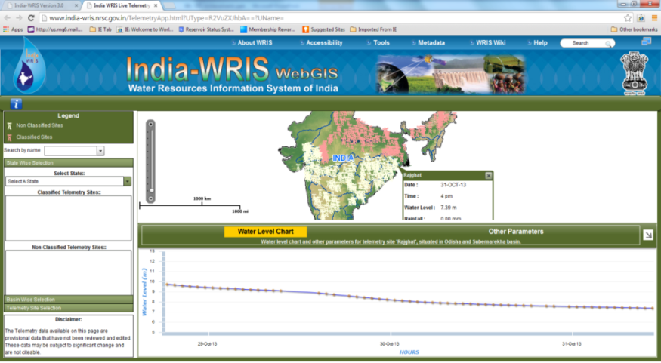
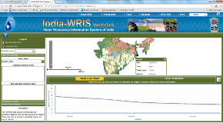
B1.National Water Resources Information System
National Hydrology Project
Database system for entry, storage, validation and visualization
National Web-based Platform for data dissemination to wider stakeholders
State WRIS

Slide 13
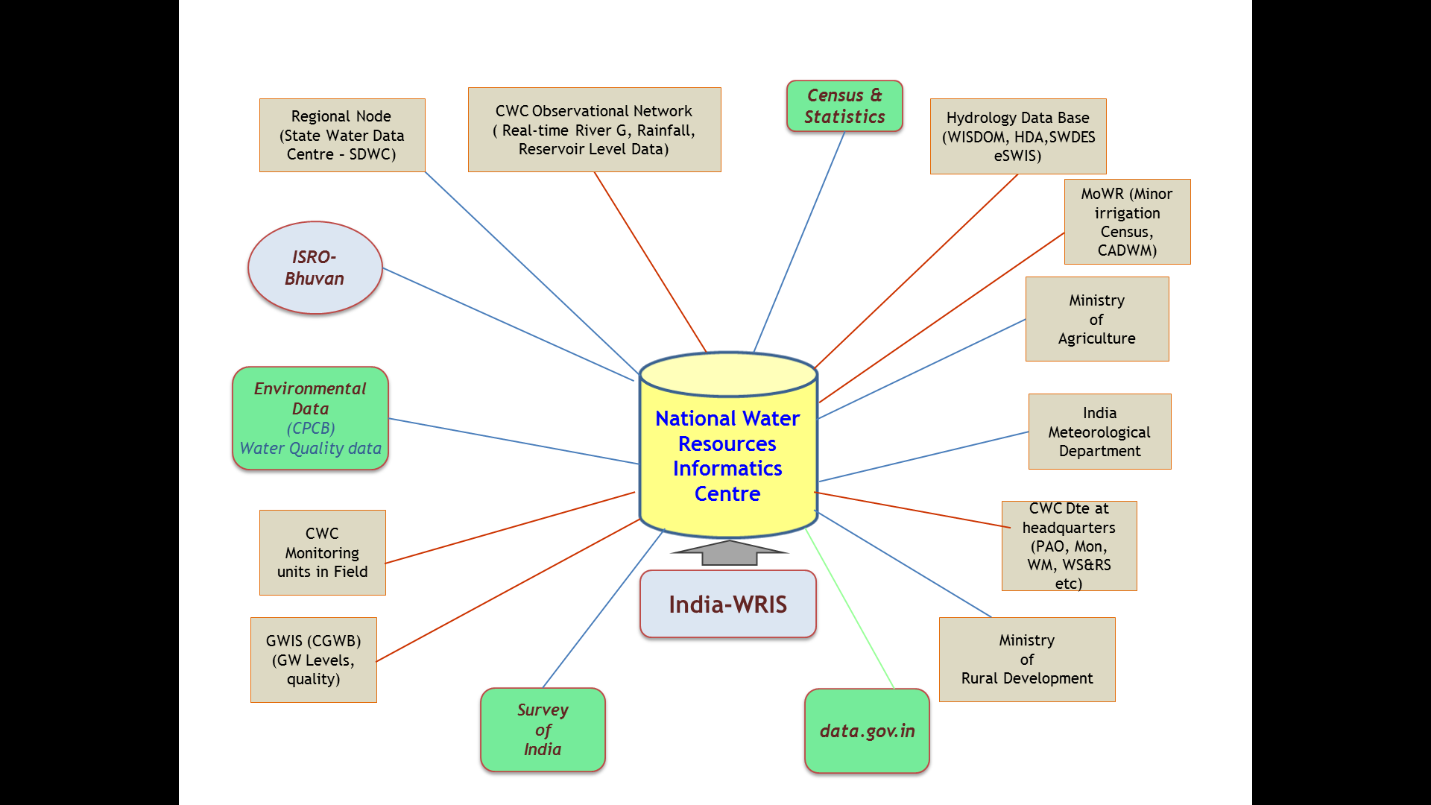
India-WRIS/NWIC
Creation of State Nodes of India-WRIS
Development of Web Services
Support for creation of State-WRIS
Linkages of various models/outputs

Slide 14
NWRIS
MOWR, RD & GR
SOI
Elevation Model
NWIC
IMD
Met & Forecast Data
NRSC
Remote Sense Data
River Basin Data
Centralized Data
India WRIS
(CWC)
Water Resources Agencies and other Water Allied Stakeholders for Application and R&D
CGWB
Ground Water Data
River Basin Data
River Basin Data
CPCB
Water Quality Data
River Basin Data
NIH
Training
River Basin Data
Hydro-met data
River Basin Data
State WRIS
State WRIS
State WRIS

Slide 15
B: Water Resources Information System
  National Products in India- WRIS
  Access to spatial information including more than 95 layers of IndiaWRIS
  Real time hydromet and reservoir level data.
  High Resolution elevation map for India ranging from (0.5 to 3m)
  Weather forecast (1, 3,5, 7 days and seasonal)
  Macro Water Resources assessment: Rainfall, ET, Runoff estimate
  Remote sensing based estimates for India: Snowmelt, real time ET, land use, irrigation benchmarking,
  Flood forecasting at major stations by CWC

Slide 16
B2.State Water Resources Information System
  The states will follow the India-WRIS standards for integration,
  The purpose of State-WRIS is to “serve” and exchange with other stake holders such as Drinking, Agriculture and watershed Department.
Development of State-WRIS
Digitization of Water related data

Slide 17
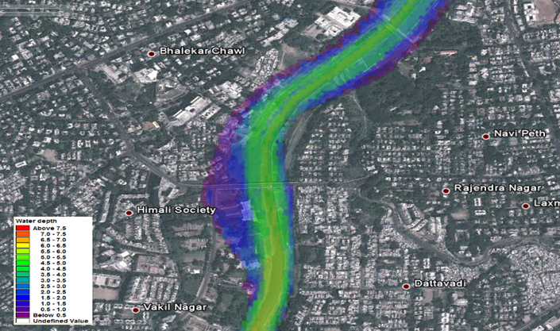
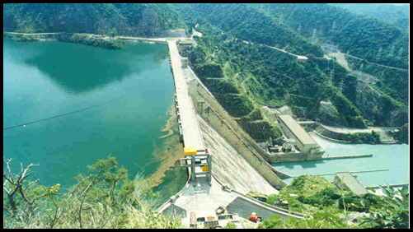
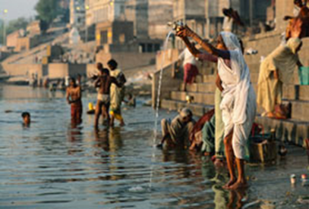
C: Water Resources Operation and Planning
C1. Analytic and DSS Tools
C2.Proposed Driven Studies
C3. Knowledge Products

Slide 18
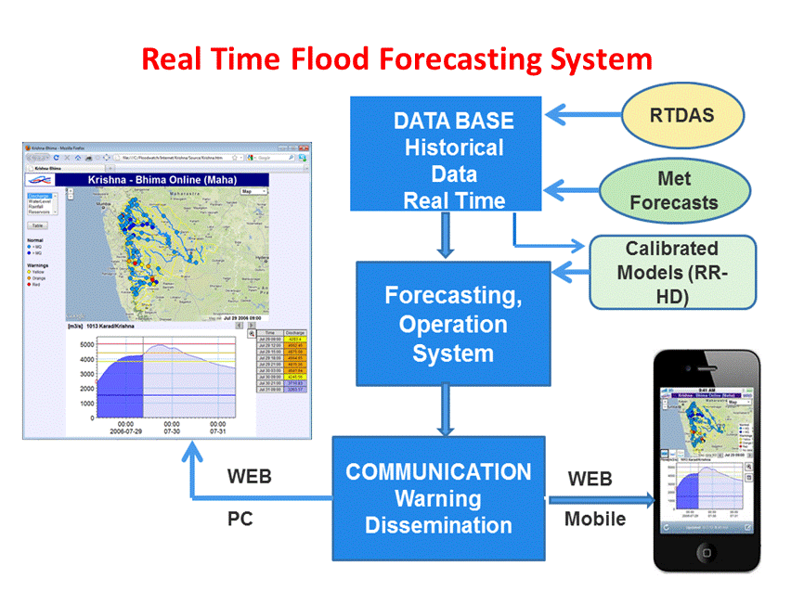
C1. Analytic and DSS Tools
Water Resources Assessment
Flood forecasting and early warning system (coupled with Climate forecast)
IWRM planning
Sediment Transport
Environmental Flow/ aquatic life assessment

Slide 19
Basin name
 | Flood Modelling | DSS for IWRM | Regional Water Availability Model | Sediment Transport Modelling | Aquatic Life Assessment
Area of North Ladakha not draining into Indus Basin
Barak and others Basin |  |  |  | Yes
Brahmani and Baitarni Basin |  |  | Yes
Brahmaputra Basin | Yes |  | Yes | Yes | Yes
Cauvery Basin | Yes |  | Yes
East flowing rivers between Godavari and Krishna Basin |  |  | Yes
East flowing rivers between Krishna and Pennar Basin |  |  | Yes
East flowing rivers between Mahanadi and Godavari |  |  | Yes
East flowing rivers between Pennar and Cauvery Basin |  |  | Yes
East flowing rivers South of Cauvery Basin |  |  | Yes
Ganga Basin | Yes | Yes | YES | Yes
Godavari Basin | Yes | Yes | YES |  | Yes
Indus (Up to border) Basin | Yes |  | Yes |  | Yes
Krishna Basin | Yes |  | Yes
Mahanadi Basin | Yes | Yes | Yes | Yes
Mahi Basin | Yes |  | Yes
Minor rivers draining into Bangladesh Basin
Minor rivers draining into Myanmar Basin |  |  | YES
Narmada Basin | Yes |  | Yes |  | Yes
Pennar Basin | Yes | Yes | Yes
Sabarmati Basin |  |  | YES
Subernarekha Basin | Yes | Yes | Yes
Tapi Basin | Yes | Yes |  | Yes
West flowing rivers of Kutch and Saurashtra including Luni Basin |  |  |  |  | Yes
West flowing rivers South of Tapi Basin |  |  |  |  | Yes

Slide 20
Development of DSS for Irrigation Water Management
Objectives
To develop Decision Support System for irrigation water distribution and management
To enhance irrigation water use efficiency
Deliverables
Cropping pattern and crop progress
Crop condition
In-season irrigation water demand
Optimal irrigation schedule

Slide 21
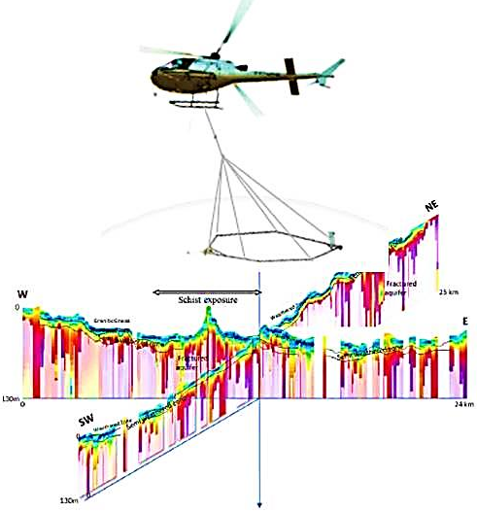
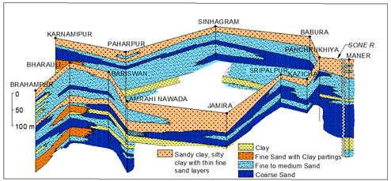
Ground Water Management
Support National Aquifer Mapping program through innovative systems
Study Surface-groundwater interaction
Community based groundwater monitoring and management
Decision Support System (DSS) for ground water development, management and artificial recharge

Slide 22
C2. Purpose Driven Studies
Specialized studies – R & D component
Some key topics includes:
Dam Break Analysis
Salinity intrusion in costal aquifers
Cloud burst
Glacier Lake Outburst Flood (GLOF)
Reservoir Sedimentation
Water Quality Studies
Irrigation system benchmarking
Effectiveness of groundwater recharging
Impacts of checkdams on flow regime of rivers/ rivulets

Slide 23
D: Institutional Capacity Enhancement
D1. Water Resources Knowledge Centre
D2.Professional Development
D3. Project Management and Technical Assistance
D4: Operating expenses

Slide 24

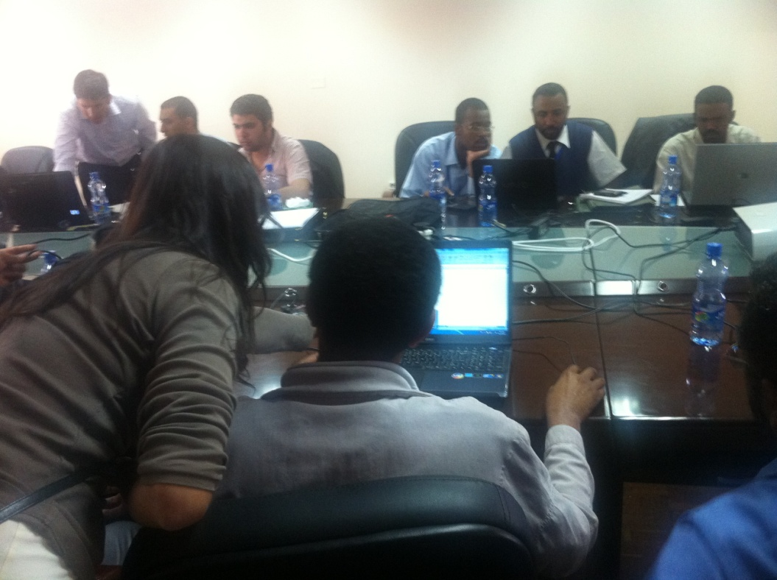
D1. Water Resources Knowledge Centre
  River basin modelling centers (Selective river basins to pilot ):
  - Krishna
  - Mahanadi
  - Damodar
  Groundwater modelling center (Selective region/issue):
  - Hardrock
  - Alluvial
  Centre of Excellent for Water Management
    - North East Centre of Excellent for Water – Guwahati
    - ??
Facilitate knowledge exchange:
  - With internationally reputed Institutes
  - States may consider reforming WALMIs/IMTI

Slide 25
D2.Professional Development
National Annual Training calendar will be prepared at the start of each financial year covering a wide range of water management aspects.
States with design customized training program based on their needs and issues.
National/ international tours will be conducted for cross-learning
Collaboration will be done with reputed academic institutions (national/ international)
NHP will support specialized degree program/certificate courses.
Focus will also be made on development of web-based training course.
National, regional and state workshop; discussion forum etc

Slide 26
NATIONAL HYDROLOGY PROJECT (NHP) : INSTITUTIONAL IMPLEMENTATION ARRANGEMENTS
National Level Steering Committee (NLSC)
Chaired by Secretary, MoWR,RD & GR
NHP
International
Advisor Committee
NHP Financial Review Committee
(NHP-FRC)
Chaired by Special Secretary, MOWR, RD & GR
NHP Technical Review Committee
(NHP-TRC)
Chaired by Member (RM), CWC
NATIONAL
NHP
Technical and Management Consultant (TAMC)
National Water Informatics Centre (NWIC)
Central Project Management Unit (CPMU)
Headed by Joint Secretary (Admin)
Technical Consultant:
CWC – River Basin Modelling
CGWB–Modelling Consultant (GW)
SOI – Lidar Survey
NIH – Training/ capacity building consultant
CENTRAL
AGENCIES
Coordinators of Central Agencies
CWC, CGWB, NIH, CWPRS, CPCB, SOI, IMD,NRSA,
River Basin Organization
BBMB & DVC
State Level Project Steering Committee (SLPSC)
Chaired by Secretary, WRD
STATE/UT
NHP-State Project Review Committee (NHP-SPRC)
Chaired by CE/Director
Nodal Officers of Central Agencies (PIUs)
CWC, CGWB, NIH, CWPRS, CPCB, SOI, IMD,NRSA, BBMB, DVC
State Level Support Consultants
State Project Management Unit (SPMU)
Headed by SE/Project Director

Slide 27
'If You Can't Measure It, You Can't Manage It‘
Thank you

